Slide 1
Video Games Sales Analysis
By:James McGinty

Slide 2
Project Overview & Tools used
This project explores global video game sales data to uncover trends in genres, regional preferences, platform success, and publisher performance
Understanding sales performance can guide game developers, publishers, and marketers in making informed decisions
The data is from VGChartz.com in the form of a CSV file that includes thousands of records about physical games sales worldwide
The games were released between the 1980s and mid 2010s.
Juypter notebook was used for all viewing, cleaning, and analysis of the dataset
The python libraries that were used are pandas, numpy, matplotlib, and seaborn.

Slide 3
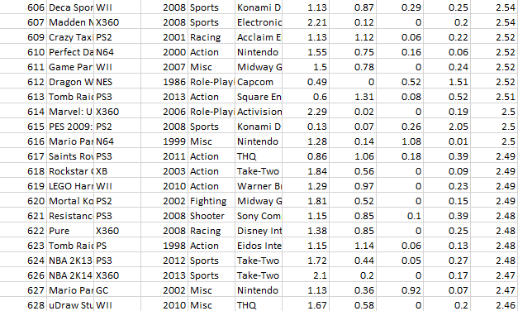
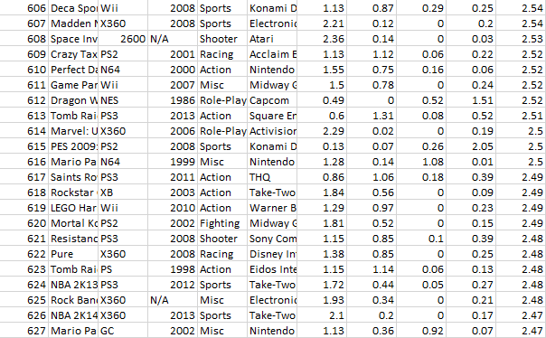
Data Exploration & Cleaning
Condensed to 1000 rows
Standardized column names and data types
Removed/handled NaN values

Slide 4
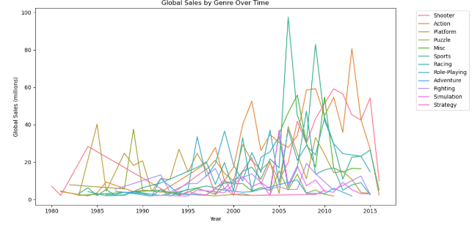
Question 1:Which video game genres have generated the most global sales over time?
Grouped by Genre, summed Global_sales
Action, Sports, and Shooter are the most popular globally

Slide 5
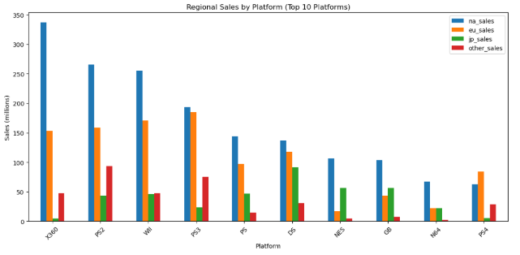
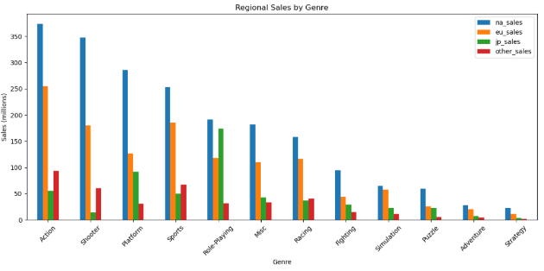
Question 2:Are there clear regional preferences for certain genres or platforms?
Grouped Sales by region and genre/platform
Japan prefers RPGs/Platform, NA prefers Action/Shooters, and Europe prefers Action/Sports
Game design and marketing should be region-specific

Slide 6
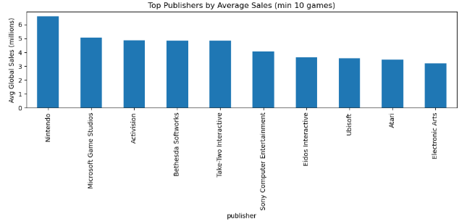
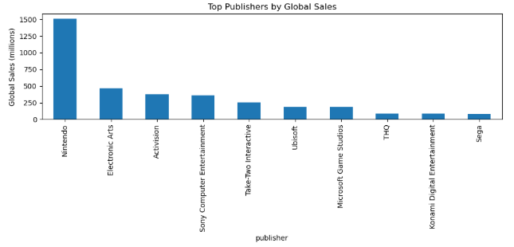
Question 3:Which publishers consistently release high-performing games?
Grouped by Publisher, filtered by total global sales/average global sales
Franchises and brand loyalty matter
Nintendo,EA,Activision

Slide 7
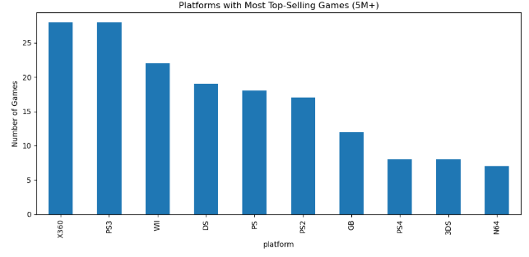
Question 4:Which platforms have the most top-selling titles?
Counted games with at least 5 million global sales, grouped by platform
Xbox 360, PS3, and Wii have the most top-selling games

Slide 8
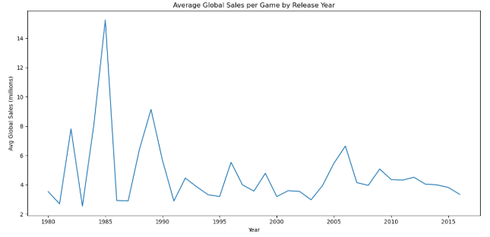
Question 5:Do older games have better sales performance than newer releases?
Line plot of year vs avg global sales
Sales peaked during mid-1980s
Recent years show decline, likely due to the shift to digital sales

Slide 9
Insights & Recommendations
Insights
Action, Shooter, and Sports games consistently generate high sales.
North America favors shooters and sports games, while Japan prefers RPGs.
Nintendo and Electronic Arts are consistent top performers.
The Xbox 360 and PS3 have the most top-selling titles.
Older games (1980-1990) had higher average sales compared to recent years
Recommendations
Invest in franchises with established success in the Action, Sports, and Shooter genres.
Tailor game development and marketing efforts based on regional tastes—e.g., localizing RPGs for Japan or emphasizing multiplayer Shooters in North America.
Prioritize releases on platforms with large user bases and broad demographic appeal.
Strategize launch windows for long-term sales performance rather than short-term trends, considering factors like holiday seasons and console life cycles

Slide 10
Future Work
Incorporate critic/user ratings to study their influence on sales
Incorporate digital sales to evaluate current day trends
Explore seasonal trends in release dates and sales performance
Develop a predictive model to estimate a game’s sales based on its attributes
Analyze sales by franchise
Investigate marketing budget vs sales

Slide 11
THANKS

